Slide 1
Peer-to-Peer Multimedia Streaming Using BitTorrent
Shanbo Li
Sike Huang
SEDS 07, KTH

Slide 2
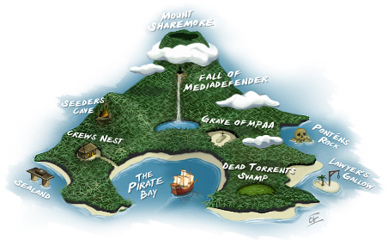
BitTorrent
Leech
down/up-load
Seed
upload
Swarm
overylay
Tracker
manager

Slide 3
Polices in BT
Rarest-first
least replicated chunks
Tit-for-tat
choking, deter free rider
Optimistic unchoking
reserver upload BW to random peers

Slide 4



BT + Multimedia
I’m scalable, efficient, cost-effective, self-improving, easy to deploy…
W-A-I-T !
Two problems:
Dowload NOT in sequence
Tit-for-tat
Marry Me

Slide 5



Work this out
Propose two modifications in BT:
Chunk selection policy
Neighbor selection policy

Slide 6
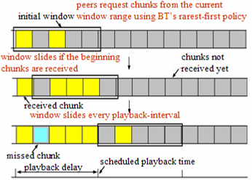
Chunk selection policy
NOT in sequence
Sliding window
w: size of window
d: playback delay
b: vido consumption rate
c: chunk size

Slide 7
Neighbor selection policy
Advantaged peers favor each other
Slower peers suffer from slow start
Each peer selects neighbors at random for the randomized chocking interval
At the beginning of every playback
Use tit-for-tat policy until the end of the playback duration to deter free riding
Once they have chunks to exchange peers

Slide 8
Experimental Setup

Slide 9
Experimental Setup
Homogeneous setting
All leeches within a sub-network have the same link band width
Assumed the idealized performance of TCP
Neglect network propagation
Ignore the packages used by peers to request chunks

Slide 10
Measure the performance
Success ratio
Normalized network throughput

Slide 11
Experimental Result

Slide 12
Chunk selection policy

